Slide 1
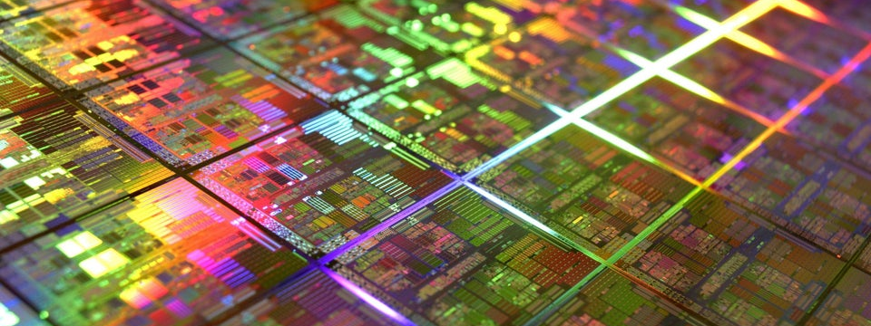
Slide Deck 15
ECE 4203 VLSI Design

Slide 2
Outline
Clock System Architecture
Phase-Locked Loops
Delay-Locked Loops

Slide 3
Clock Generation
Low frequency:
Buffer input clock and drive to all registers
High frequency
Buffer delay introduces large skew relative to input clocks
Makes it difficult to sample input data
Distributing a very fast clock on a PCB is hard

Slide 4
Zero-Delay Buffer
If the periodic clock is delayed by T_{c}, it is indistinguishable from the original clock
Build feedback system to guarantee this delay
Phase-Locked
Loop (PLL)
Delay-Locked
Loop (DLL)

Slide 5
Frequency Multiplication
PLLs can multiply the clock frequency
Distribute a lower frequency on the board
Multiply it up on-chip
Possible to adjust the frequency on the fly

Slide 6
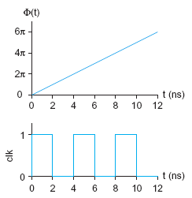
Phase and Frequency
Analyze PLLs and DLLs in term of phase Φ(t) rather than voltage v(t)
Input and output clocks may
deviate from locked phase
Small signal analysis

Slide 7
Linear System Model
Treat PLL/DLL as a linear system
Compute deviation ΔΦ from locked position
Assume small deviations from locked
Treat system as linear for these small changes
Analysis is not valid far from lock
e.g. during acquisition at startup
Continuous time assumption
PLL/DLL is really a discrete time system
Updates once per cycle
If the bandwidth << 1/10 clock freq, treat as continuous
Use Laplace transforms and standard analysis of linear continuous-time feedback control systems

Slide 8
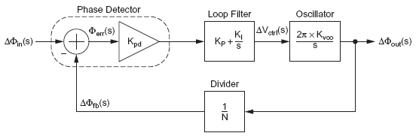
Phase-Locked Loop (PLL)
System
Linear Model

Slide 9
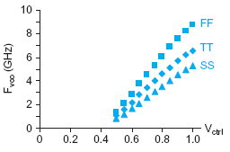
Voltage-Controlled Oscillator
VCO
-
+

Slide 10
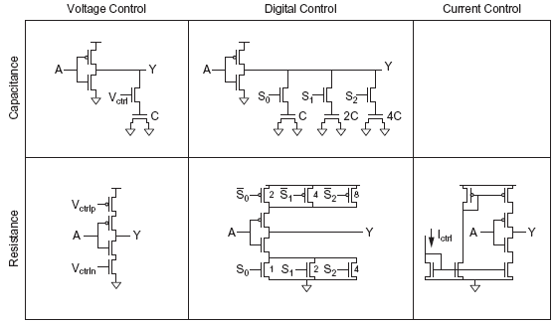
Alternative Delay Elements

Slide 11
Frequency Divider
Divide clock by N
Use mod-N counter

Slide 12
Phase Detector
Difference of input and
feedback clock phase
Often built from phase-frequency detector (PFD)

Slide 13
Phase Detector
Convert up and down pulses into current proportional to phase error using a charge pump

Slide 14
Loop Filter
Convert charge pump
current into V_{ctrl}
Use proportional-integral control (PI) to generate a control signal dependent on the error and its integral
Drives error to 0
(negligible)

Slide 15
PLL Loop Dynamics
Closed loop transfer function of PLL
This is a second order system
ω_{n} indicates loop bandwidth
ζ indicates damping; choose 0.7 – 1 to avoid ringing

Slide 16
Delay Locked Loop
Delays input clock rather than creating a new clock with an oscillator
Cannot perform frequency multiplication
More stable and easier to design
1st order rather than 2nd
State variable is now time (T)
Locks when loop delay is exactly T_{c}
Deviations of ΔT from locked value

Slide 17
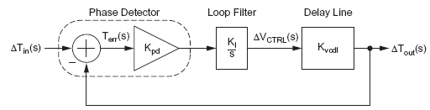
Delay-Locked Loop (DLL)
System
Linear Model

Slide 18
Delay Line
Delay input clock
Typically use voltage-controlled delay line

Slide 19
Phase Detector
Detect phase error
Typically use PFD and charge pump, as in PLL

Slide 20
Loop Filter
Convert error current
into control voltage
Integral control is sufficient
Typically use a capacitor as the loop filter

Slide 21
DLL Loop Dynamics
Closed loop transfer function of DLL
This is a first order system
τ indicates time constant (inverse of bandwidth)
Choose at least 10T_{c} for continuous time approx.

